Slide 1
Representing Programs
IT 301

Slide 2
Topics
Architecture fundamentals
Threads
Java Virtual Machine
Components and architecture
Compilation process
Memory areas
Linking
Garbage collection

Slide 3
Architecture fundamentals
Representing programs

Slide 4
Instruction sets
Instruction set: a set of commands that a CPU will respond to
Typical commands
Arithmetic: ADD, SUB, MULT, DIV, …
Logical: AND, OR, XOR, NOT, …
Control flow (decisions, loops): branch, jump
Assignment: load, store
Instruction sets by name
MIPS, Sun SPARC, Intel x86-x64, …

Slide 5
Assembly and machine code
Machine language: binary instructions that a CPU can directly execute
1000110010100000
Assembly language: symbolic representation of machine code instructions
add A, B
High level language: modern languages like c++ or Java
eg. A + B
Conversion between languages
Assembler: converts assembly code to binary machine code
Compiler: converts high level code to assembly or machine code
Assembly language
High level language
Machine language

Slide 6
Code translation
swap(int v[], int k)
{ int temp;
temp = v[k];
v[k] = v[k + 1]; }
swap:
muli $2, $5,4
add $2, $4,$2
lw $15, 0($2)
lw $16, 4($2)
sw $16, 0($2)
sw $15, 4($2)
jr $31
compiler
compiler
assembler
00000000101000010000000000011000
00000000000110000001100000100001
10001100011000100000000000000000
10001100111100100000000000000100
10101100111100100000000000000000
10101100011000100000000000000100
00000011111000000000000000001000

Slide 7
Elements of an instruction
Each instruction begins with an opcode
Opcode: signifies the type of operation to perform
The opcode is followed by optional operands, literal values, offsets, misc fields
The elements of an instruction depend on the instruction and instruction set
Example – MIPS
op | rs | rt | rd | shamt | funct
6 bits | 5 bits | 5 bits | 5 bits | 5 bits | 6 bits
Opcode
Source registers
Destination register
Shift amount, function variant

Slide 8
Registers and program counters
Each architecture has a finite number of registers to hold intermediate values during a calculation
Example - MIPS
op | rs | rt | rd | shamt | funct
6 bits | 5 bits | 5 bits | 5 bits | 5 bits | 6 bits
R0
R1
R2
R3
R4
…
R31
32 registers

Slide 9
MIPS registers by name
Register | Alternative | Description
0 | zero | the value 0
1 | $at | (assembler temporary) reserved by the assembler
2-3 | $v0 - $v1 | (values) from expression evaluation and function results
4-7 | $a0 - $a3 | (arguments) First four parameters for subroutine. Not preserved across procedure calls
8-15 | $t0 - $t7 | (temporaries) Caller saved if needed. Subroutines can use w/out saving. Not preserved across procedure calls
16-23 | $s0 - $s7 | (saved values) - Callee saved. A subroutine using one of these must save original and restore it before exiting. Preserved across procedure calls
24-25 | $t8 - $t9 | (temporaries) Caller saved if needed. Subroutines can use w/out saving. These are in addition to $t0 - $t7 above. Not preserved across procedure calls.
26-27 | $k0 - $k1 | reserved for use by the interrupt/trap handler
28 | $gp | global pointer. Points to the middle of the 64K block of memory in the static data segment.
29 | $sp | stack pointer Points to last location on the stack.
30 | $s8/$fp | saved value / frame pointer Preserved across procedure calls
31 | $ra | return address

Slide 10
Using registers
result
operands
add $s1, $s2, $s3
Registers
R0
…
$s1 = ?
$s2 = 20
$s3 = 30
…
R31
R0
…
$s1 = 50
$s2 = 20
$s3 = 30
…
R31
store result in register
access operands in registers

Slide 11
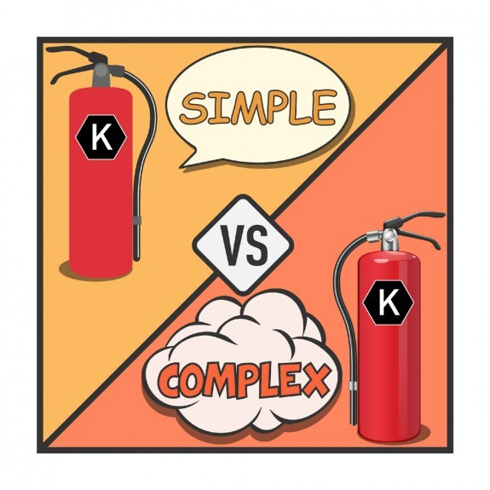
CISC vs. RISC
RISC (Reduced Instruction Set Computing)
Prefers simpler instructions
Requires less hardware complexity required to execute instructions
Emphasis on software
Requires more work translating to assembly for a compiler
CISC (Complex Instruction Set Computing)
Prefers complex instructions
Requires less instructions to accomplish a task
Requires more hardware complexity to handle instructions
Emphasis on hardware
Requires less work translating to assembly for a compiler

Slide 12
Threads
Representing programs

Slide 13
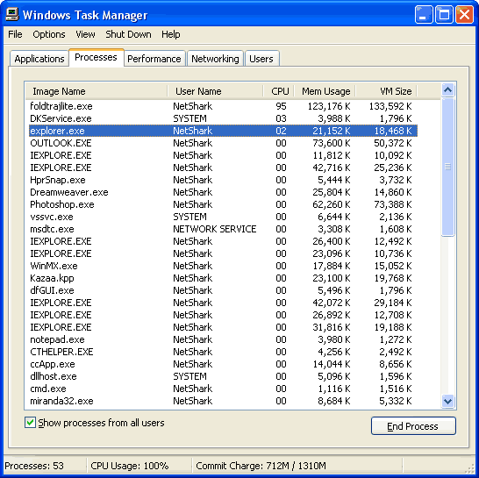
Processes
Process:
A single unit of execution on your CPU
Has its own private address space
Address space: a range of addressable memory locations
Is scheduled for execution on a CPU
Multiple processes can be executed simultaneously

Slide 14
Threads introduction
Thread: A single unit of execution on your CPU
Set of registers:
hold instructions and data values before, during and after computation
Program counter (PC):
holds the memory address of the current CPU instruction
Call stack:
holds method data during method invocation
code
data
files
registers
stack
thread

Slide 15
Multiple threads
Multiple threads can run simultaneously within a software program
Data is shared between threads
Each thread has its own registers and stack for computations
code
data
files
registers
registers
registers
stack
stack
stack

Slide 16

Threads vs. processes
Threads are not the same as processes
All threads must run within a process
Processes have their own memory space
Threads share the memory space of their containing process

Slide 17

Thread interleaving
Processes or threads are only allotted a finite amount of CPU processing time
CPU time is managed by a scheduler
Instructions are interleaved on a CPU
Threads “appear” to execute simultaneously
Thread A
StepA1
StepA2
StepA3
Thread B
StepB1
StepB2
StepB3
Execution Order
StepB3
StepA3
StepB2
StepB1
StepA2
StepA1

Slide 18
The Java Virtual Machine
Representing programs

Slide 19

What is the Java Virtual Machine?
Abstract computing machine”
Provides an environment for running Java programs
Hardware and system independent
Architecture neutral (instruction set used by your CPU)
OS neutral (Windows, MAC, Linux, Unix, …)

Slide 20
What is the Java Virtual Machine?
JVM can refer to a(n)
abstract specification
Specifies the general behavior and attributes of the JVM
concrete implementation
Built by a designer to run Java programs in a specific environment (web, mobile, server, embedded systems)
runtime instance
An instance of the JVM that a Java program runs inside
Runs only one Java program

Slide 21
JVM life-cycle
JVM Startup
JVM invokes a main() method
JVM terminates
Java program terminates
Program executes
can be forced
using System.exit()

Slide 22
JVM components
Class loader
Bytecode verifier
Interpreter
Thread scheduler
Garbage Collector
Compiler
JVM

Slide 23
Compilation
The Java virtual machine

Slide 24

Traditional compilation
Editor
(IDE)
Source Code
Compiler
Machine
(Native)
Code
//print the tax owed double salesTotal = 10.99;
double taxRate = 0.95;
double tax = salesTotal * taxRate;
System.out.println(tax);
0x 60 00 00 80
0x A4 00 00 00
0x 60 01 00 84
0x A4 01 01 00
0x 60 02 00 00
0x 60 03 00 04
0x 60 04 00 00

Slide 25
Java Compilation
The JVM is not aware of Java as a programming language
Java files are compiled into a binary format called bytecode
Bytecode is an intermediate language between
Java Code (high level – what a developer understands)
Native machine code (low level – what a processor understands)
High Level
Bytecode
Low Level
Native Code
Java
Intermediate
myFile.java
myFile.class

Slide 26
The long road to code execution
Compilation
Process
Java Virtual
Machine
Code
Execution
Editor
(IDE)
Oracle
Hotspot
JVM Implementation
ARM64 Processor
Source Code
AMD
x64 Processor
Oracle
JRockit
JVM Implementation
Compiler (javac)
Intel
x86 Processor
Class File

Slide 27
Execution engine strategies
Fully interpreted
Interprets bytecode line-by-line
Just-in-time compilation (JIT)
Compiles a method's bytecode to native machine code as encountered during runtime
Caches the machine code for reuse
Adaptive optimizer
Monitors a Java program during use
Converts heavily used sections of bytecode to native machine code

Slide 28
Java compilation
Editor
(IDE)
Source Code
Compiler
Bytecode
Interpreter
Machine
(Native)
Code
JIT Compiler

Slide 29
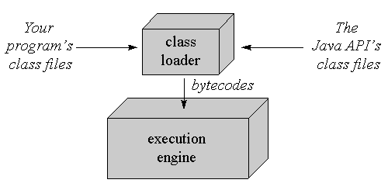
JVM components – Class loader
Locates and loads class files for Java types
Passes bytecode to a Bytecode Verifier to check for invalid segments
These can occur from
Faulty JVMs
Malicious programmers
Passes class data to the virtual machine so it can save it to the Java runtime memory areas

Slide 30
Runtime memory areas
The Java virtual machine

Slide 31
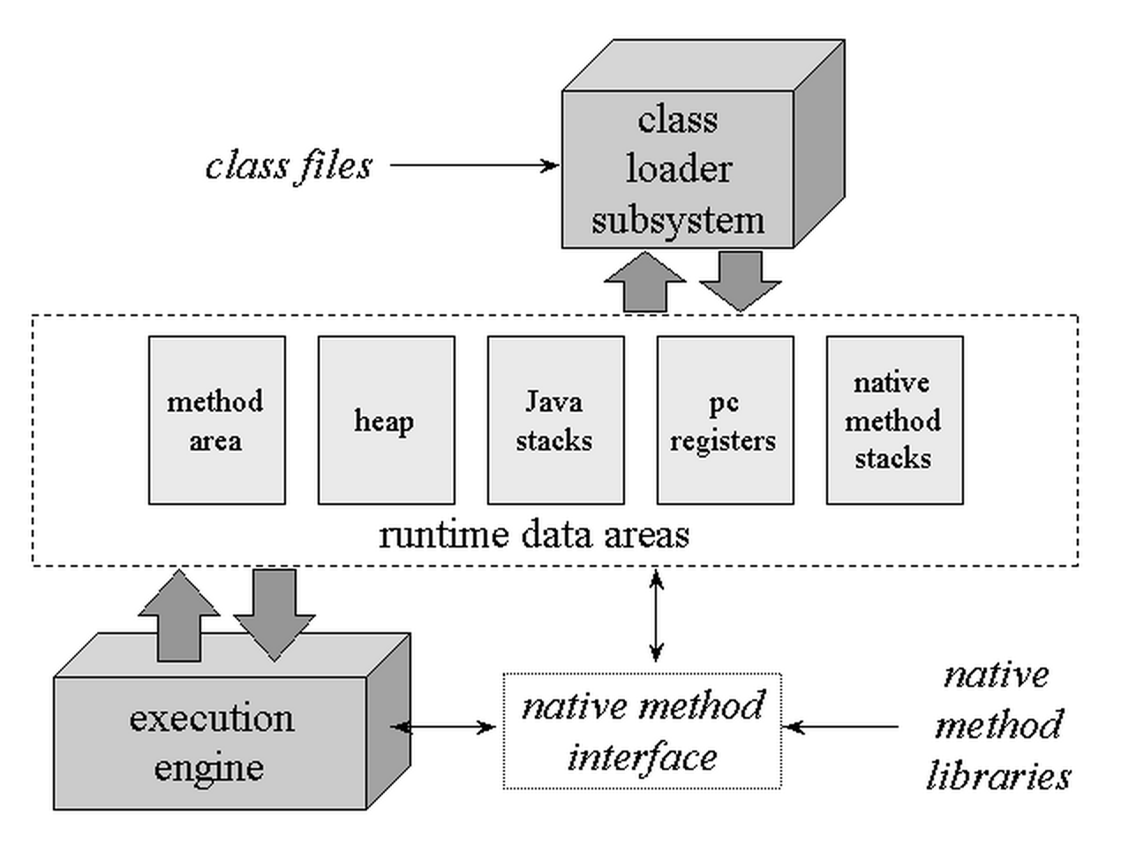
Runtime memory areas
PC registers
Java virtual machine stacks
Heap
Method Area
Runtime constant pool

Slide 32
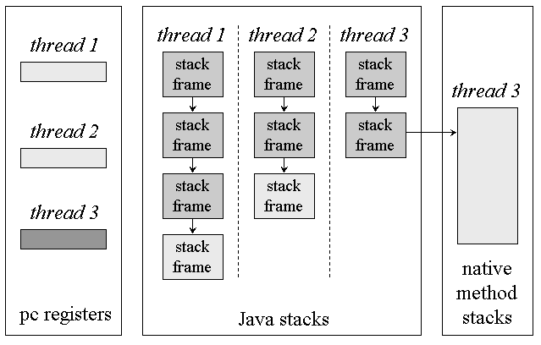
Runtime memory area – PC registers
PC (program counter) – holds the memory address of the next instruction to be executed by a thread
Unused when executing native methods

Slide 33
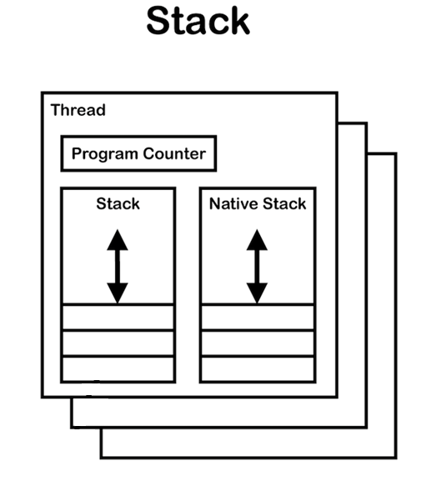
Runtime memory area - Stacks
Java virtual machine stacks
Each thread has a call stack
A stack stores stack frames, also called activation records
Frames are
created upon method invocation
destroyed upon method completion
Each thread has a native stack
Used to manage native method calls

Slide 34
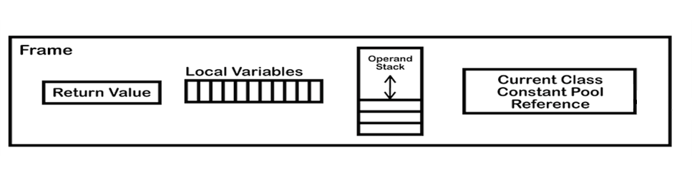
Activation frame contents
Return value
Local variables (including parameters)
Operand stack: used in tandem with byte code being executed
Constant pool: for the class the associated method belongs to

Slide 35
Java Call Stack
LIFO structure: last-in-first-out
The Call Stack can hold a finite number of activation records
Exceeding this maximum will result in a StackOverflowException
Contiguous memory location (fast!)
Local variables
boolean isValidName;
String errorMessage;
Return value
true/false
method invocation
validate()
method completion
readUser
Values()
readUser
Values()
readUser
Values()
main()
main()
main()
main()

Slide 36
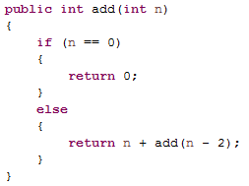
Recursion
Recursion
A method invoking itself
Alternative to loops
Rules of recursion
Include a recursive method call
Include a base case
Approach the base case
Recursive methods can often lead to StackOverflowExceptions

Slide 37
Runtime memory area - Heap
Used to allocate and deallocate dynamic memory
Stores class instances and arrays
Memory is allocated with the “new” keyword through a constructor
Memory is never explicitly deallocated (destructor)
Slower than the Call Stack
Memory locations may be non-contiguous
Memory addresses must be dereferenced
Created on virtual machine startup

Slide 38
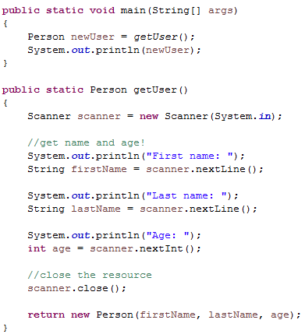
Heap
Heap Memory
Person
fName = “Bob”
lName = “Smith”
age = 42
“Bob”
“Smith”
Activation Record
Call stack
Method | getUser()
Local Variables | age = 42
Return value | result
getUser()
main()

Slide 39
Runtime memory area - Method Area
Steps to load a type in JVM
The class loader finds the associated class file
Reads the binary data in a class file
Passes the contents of the file to the JVM
Saves Type information to the Method Area
All threads shared the same Method Area

Slide 40
Method Area – contents
Method Area Content | Description
Type name | eg. java.lang.Object, java.lang.Comparable
Direct superclass | eg. mypackage.MyParentClass
Static class data | Static fields shared among instances of the class
Class or interface | Is it a class or interface?
Type modifiers | public, abstract or final
Superinterfaces | A list of super-interfaces if the type is an interface
Field metadata | Name, type, modifiers (public, private, protected, static, final, volatile, transient)
Method metadata | Name, return type, parameters, modifiers (public, private, protected, static, final, synchronized, native, final)
Constant pool | See next slide…
Instance of class Class | See next slides…
Method table | Depending on implementation

Slide 41
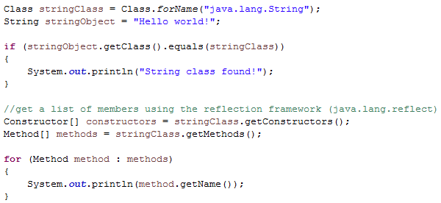
Method Area – type information
Constant pool
Constants
String and numeric literals
Symbolic references (names) of fields, methods and types
Instance of class Class
Holds information about a class itself (eg. name of the class, fields, methods, …)

Slide 42
Method Area – type information
Optional method table
Holds a list of references to each instance method of a class
This includes methods defined in a class or inherited
java.lang.Object
toString()
getClass()
edu.greenriver.it.Point2D
getX()
getY()
edu.greenriver.it.Point3D
getz()
equals()
hashcode()
toString()
toString()
edu.greenriver.it.Point3D
getClass() – Object
equals() – Object
hashcode() - Object
getX() – Point2D
getY() – Point2D
getZ() – Point3D
toString() – Point3D
Method Table

Slide 43
Linking
The Java virtual machine

Slide 44
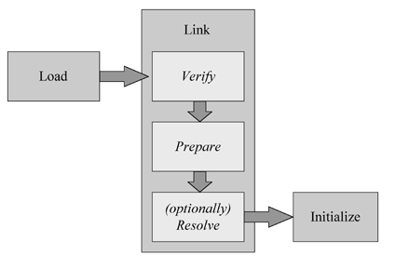
Loading, Linking and initialization
Before a class can be used it must pass through the following phases:
Loading: binary data for the class is loaded through the Class Loader
Linking: adds a class to the JVM runtime system so that it can be referenced by other classes
Initialization: class variables are given initial values

Slide 45
Linking
Verification: verifies the correct format of all bytecodes for a class
Preparation: allocates memory for the class
Resolution: resolves symbolic references in a class into direct references

Slide 46
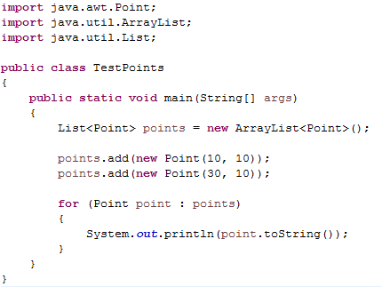
Linking resolution
Symbolic references: references in a class to another classes fields or methods
Resolution process: changing symbolic references to direct references of a loaded class
References are primarily stored in the constant pool for a class
Classes referenced for the first time are loaded
Static linking: resolves all symbolic references during the compilation step
Dynamic linking: resolves symbolic references when they are encountered
Symbolic references?
Are we missing any classes?

Slide 47
Linking resolution
A JVM is free to use either static or dynamic linking
Linking begins with an initial class
A class with a main method.
TestPoints
Point
Object
List
ArrayList

Slide 48
Garbage collector
The Java virtual machine

Slide 49
Java Garbage Collector
Reclaims memory used by objects that are no longer referenced
Reclaimed from heap memory
Automatically reclaimed on a background thread in your program
Advantages?
Ease of programming
Less likely to have memory leaks (ala c++)
Drawbacks?
Performance!
Anticipation of work!

Slide 50
Garbage collection algorithms
Job of the garage collector
Detect objects no longer referenced
Reclaim heap space
Reduce heap fragmentation

Slide 51
Definition of reachability:
Root objects: objects that are considered alive as long as the program is running
Examples
Class (static) variables, objects reference by local variables on the stack, objects in a constant pool for a class
Live object:
An object that is referenced from a root object
An object that is referenced from another live object

Slide 52
Reclaiming heap space
Objects that are not roots and are not considered live objects
Will be reclaimed
Are not guaranteed to be reclaimed immediately (or even soon)
The garbage collector algorithm/thread is responsible for determining when to reclaim the space
live due
to reference
from root
live due
to reference
from live object
Employee Manager
Static Employee
List
Employee
Address
Address field

Slide 53
Distinguishing live objects
Reference counters: keep track of a counter that tracks the references of each live object on the heap
The counter is increased when a new reference is found
The counter is decreased when the reference is reassigned or reclaimed in heap memory
The GC will reclaim objects with reference counts of zero
What could go wrong here?

Slide 54
Reference counter algorithm
Reference counters cannot detect cycles
no root reference
no root reference
ObjectA
ObjectB
references
references
references
ObjectC
no root reference

Slide 55

Mark and sweep algorithm
Start at root objects and generate a "graph" of object references encountered
Mark step: Live objects are marked in some way
Sweep step: Unmarked objects are garbage collected
ObjectA
(root)
ObjectA
(root)
ObjectB
ObjectB
ObjectD
ObjectC
ObjectC
ObjectD
ObjectD
ObjectD

Slide 56
Heap fragmentation
Similar to hard disk fragmentation
Data values are added and removed and can leave empty memory regions between used regions
This will sometimes force heap memory to expand when there is collectively room for a new object
Outcome
Degraded performance
Out of memory exceptions

Slide 57
Compacting collectors
Moves live objects to one "side" of the heap
A large unused region is maintained on the other side of the heap
Object A
Object B
Object C
Object D
Unused Space
Object A
Object B
Object C
Object D
Object E
Unused Space
Add Object E
Object A
Object B
Object C
Object E
Unused Space
Reclaim Object D

Slide 58
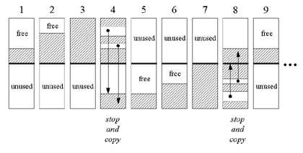
Copying collectors (stop and copy)
Maintain two regions for live objects
One region is used until full, one used, one unused
The garbage collector stops and identifies all live objects
Live objects are copied to the second region and then repeats steps 1-3

Slide 59
Generational collectors
Two common occurrences in programs can be leveraged to create a better garbage collector
Programs tend to create many objects with short lifespans
Programs tend to have a few objects with long lifespans
Generational garbage collectors create several sub-heaps to manage the groups above
New Generation
Garbage collected often
Old Generation
Objects that are not garbage collected are promoted to this heap
Tenured Generation
You can have many generations of live objects
Garbage collected less often
Garbage collected even less often

Slide 60
Java finalizers
Similar to destructors in other languages
A finalizer is guaranteed to be run before an object's memory is reclaimed on the heap
The garbage collector does not guarantee when a finalizer is called (beware!)
public class MyClass
{
protected void finalize() throws Throwable
{
//...
super.finalize();
}
//...
}

Slide 61
JVM data types
The Java virtual machine

Slide 62
Data types
The JVM has its own set of data types, most of which map to Java data types
Primitive types: byte, short, int, long, float, double, char, boolean
There is little support for boolean types
They are mapped to the int type (1 = true, 0 = false)
Reference types: class types, array types, interface types

Slide 63
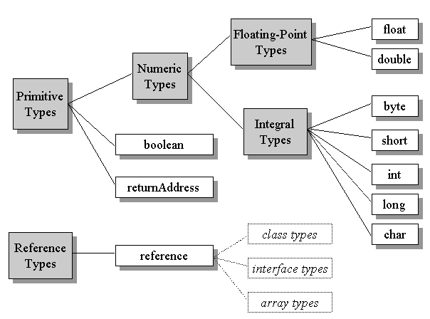

Slide 64
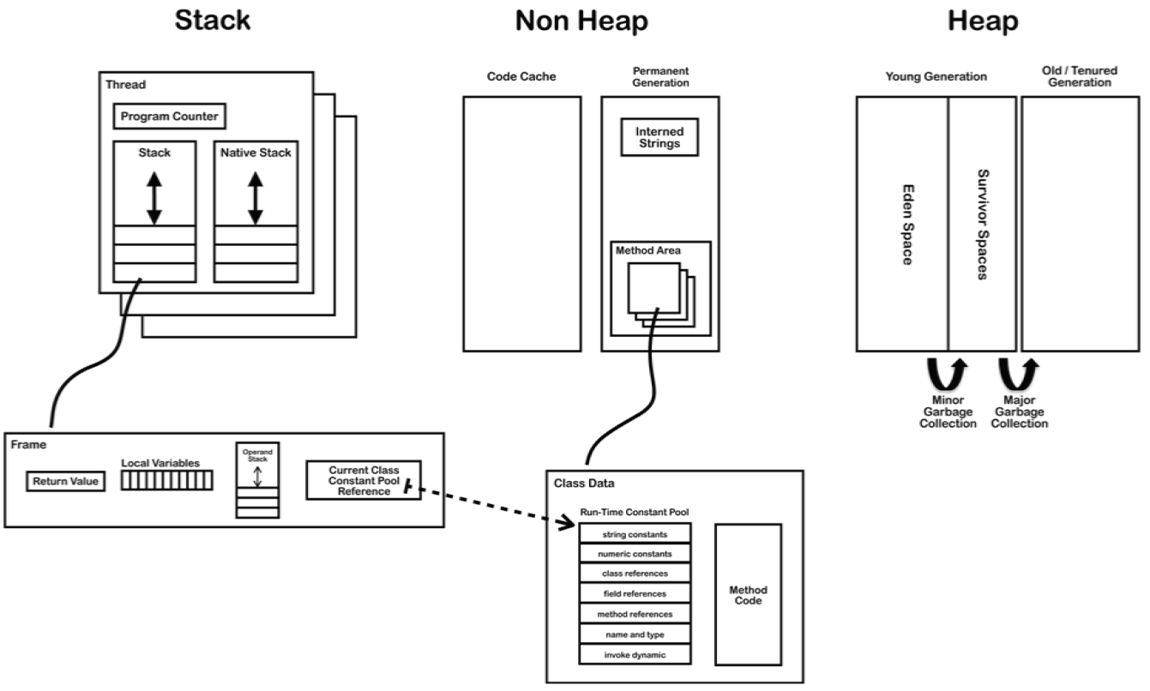
Questions?

Slide 65
Sources
https://docs.oracle.com/javase/specs/jvms/se8/html/jvms-1.html
http://www.artima.com/insidejvm/ed2/index.html
http://www.cs.uic.edu/~jbell/CourseNotes/OperatingSystems/4_Threads.html

Slide 66
Representing Programs
IT 301

